Slide 1


Session 3: Conditionals and Loops
Middlesex Computing Society: Python Programming
Arfa Kazi, Head of Python Programming

Slide 2

Last week’s recap
Different data types such as String, Integer, Float
and Boolean.
Concepts like Dynamic typing and Type
Casting.
Different operators to perform operations.
Complex data Types such as Lists, Dictionaries and Tuples

Slide 3
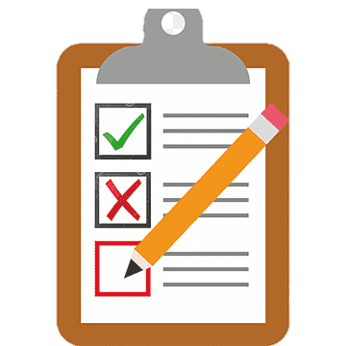
This Week’s objectives:
Grasp the idea of conditional statements and loops.
Understand the concepts of indentation, iteration and incrementation.
Learn how to use logical operators within conditionals.
Understand the structure and use of loops. Implement loops with complex data types.

Slide 4
Introduction to Conditionals and loops
Welcome to Week 3! We’re Halfway there >:D
This week, we'll dive into conditionals and loops, essential for controlling the flow of your programs.
Topics: If-else statements, for loops, while loops, nested loops and While True loops.
VERY IMPORTANT PROGRAMMING CONCEPT!!!

Slide 5
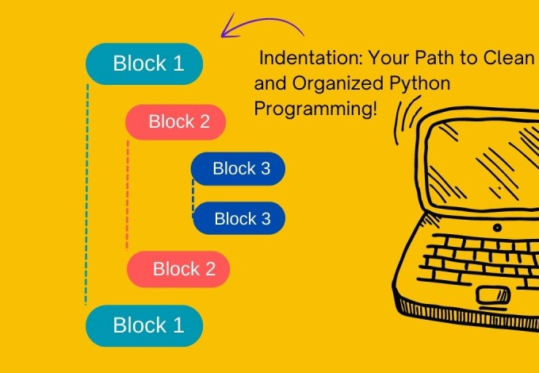
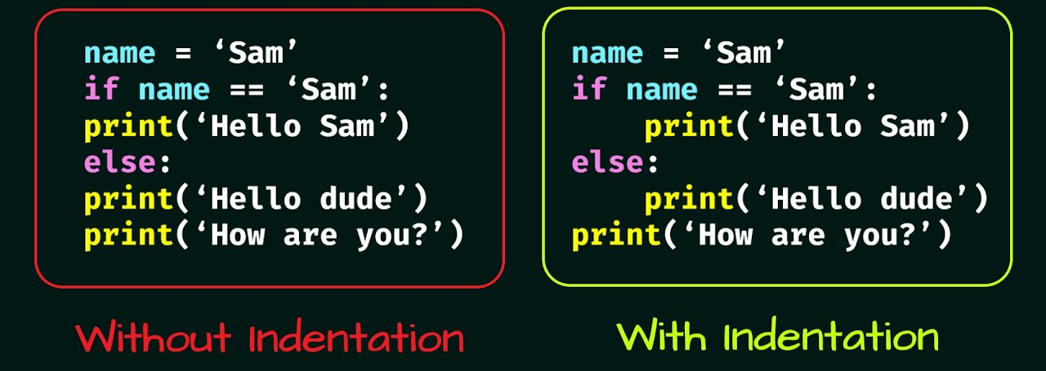
Understanding Indentation in python (IMP)
Python uses indentation to define the blocks of code. Indentation is crucial for the correct execution of the code.
Code within the same block must be indented with the same number of spaces or tabs.
Always use the same type of indentation (spaces or tabs) throughout your code. Mixing tabs and spaces can lead to errors.

Slide 6


Conditional Statements in Python
Conditional statements allow you to execute specific code blocks based on certain conditions.
They help control the flow of your program
Types of Conditional Statements:
If
elif
else

Slide 7
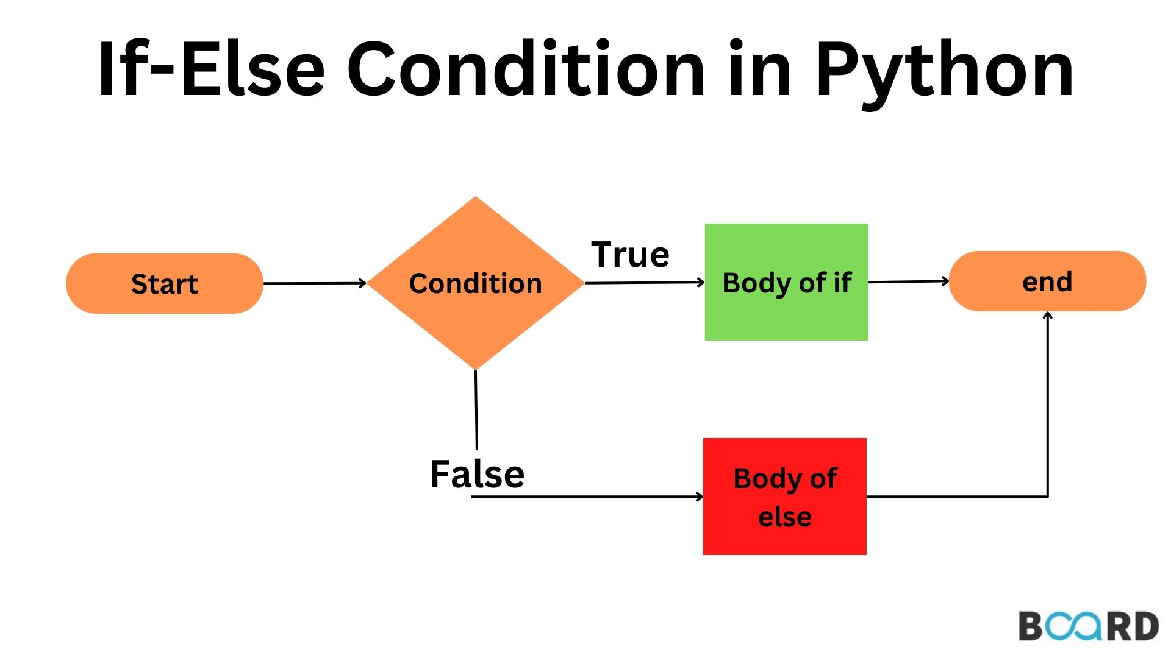
If-Else Statements
Syntax:
if condition:
# code to execute if condition is true
else:
# code to execute if condition is false

Slide 8
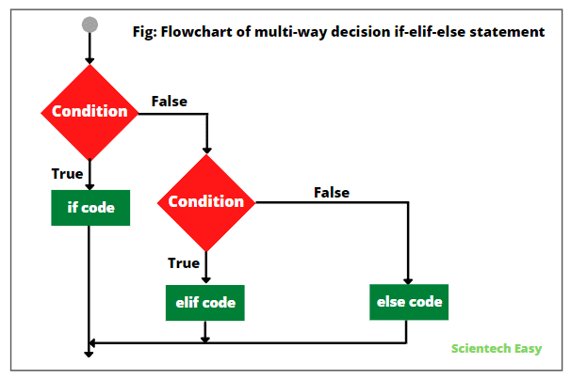
Elif (Else if) Statements Use elif to check multiple conditions.
Syntax:
if condition1:
# code to execute if condition1 is true
elif condition2:
# code to execute if condition2 is true
else:
# code to execute if all conditions are false

Slide 9

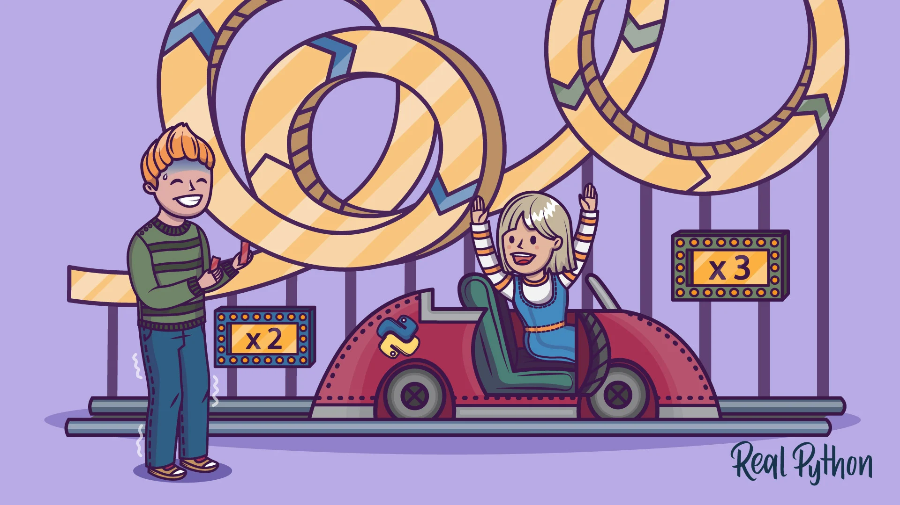
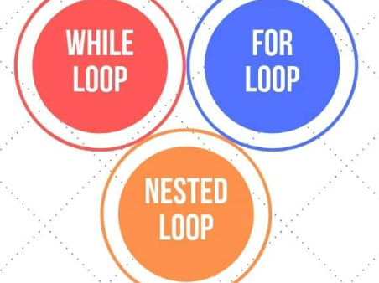
Introduction to Loops
Loops are used to execute a block of code repeatedly when a condition is true.
Types of Loops in Python:
For loop
While loop
Why Use Loops?
To automate repetitive tasks.
To iterate over sequences (e.g., lists, strings).
To reduce the amount of code.

Slide 10
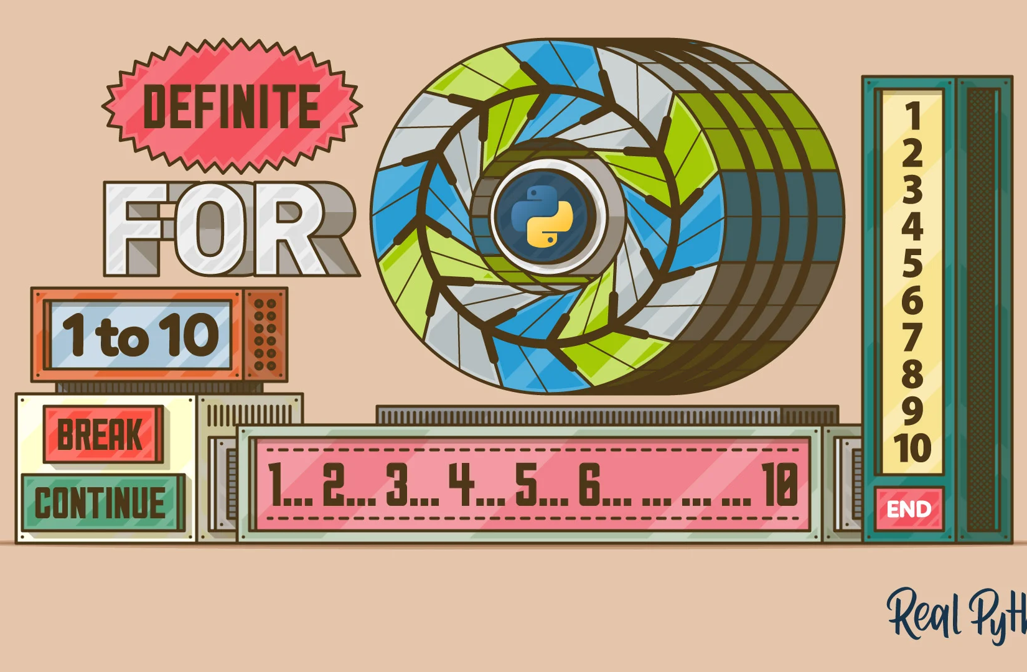
For loop
For loops is used to iterate over a sequence (e.g., list, tuple, string) and execute a block of code for each item in the sequence.
Useful for iterating over items in a collection.
Commonly used for looping through arrays or strings.
Syntax:
for variable in iterable:
# code to execute in each iteration

Slide 11
In and Range Keywords
In
Range
The in keyword is used to check if an item exists within a sequence (such as a list, tuple, or string).
Returns Boolean.
Used in checking for membership
item in sequence
The range function generates a sequence of numbers, which is commonly used to iterate over with for loops.
Returns a sequence of numbers
Used in looping a set number of times.
range(start, stop, step)

Slide 12
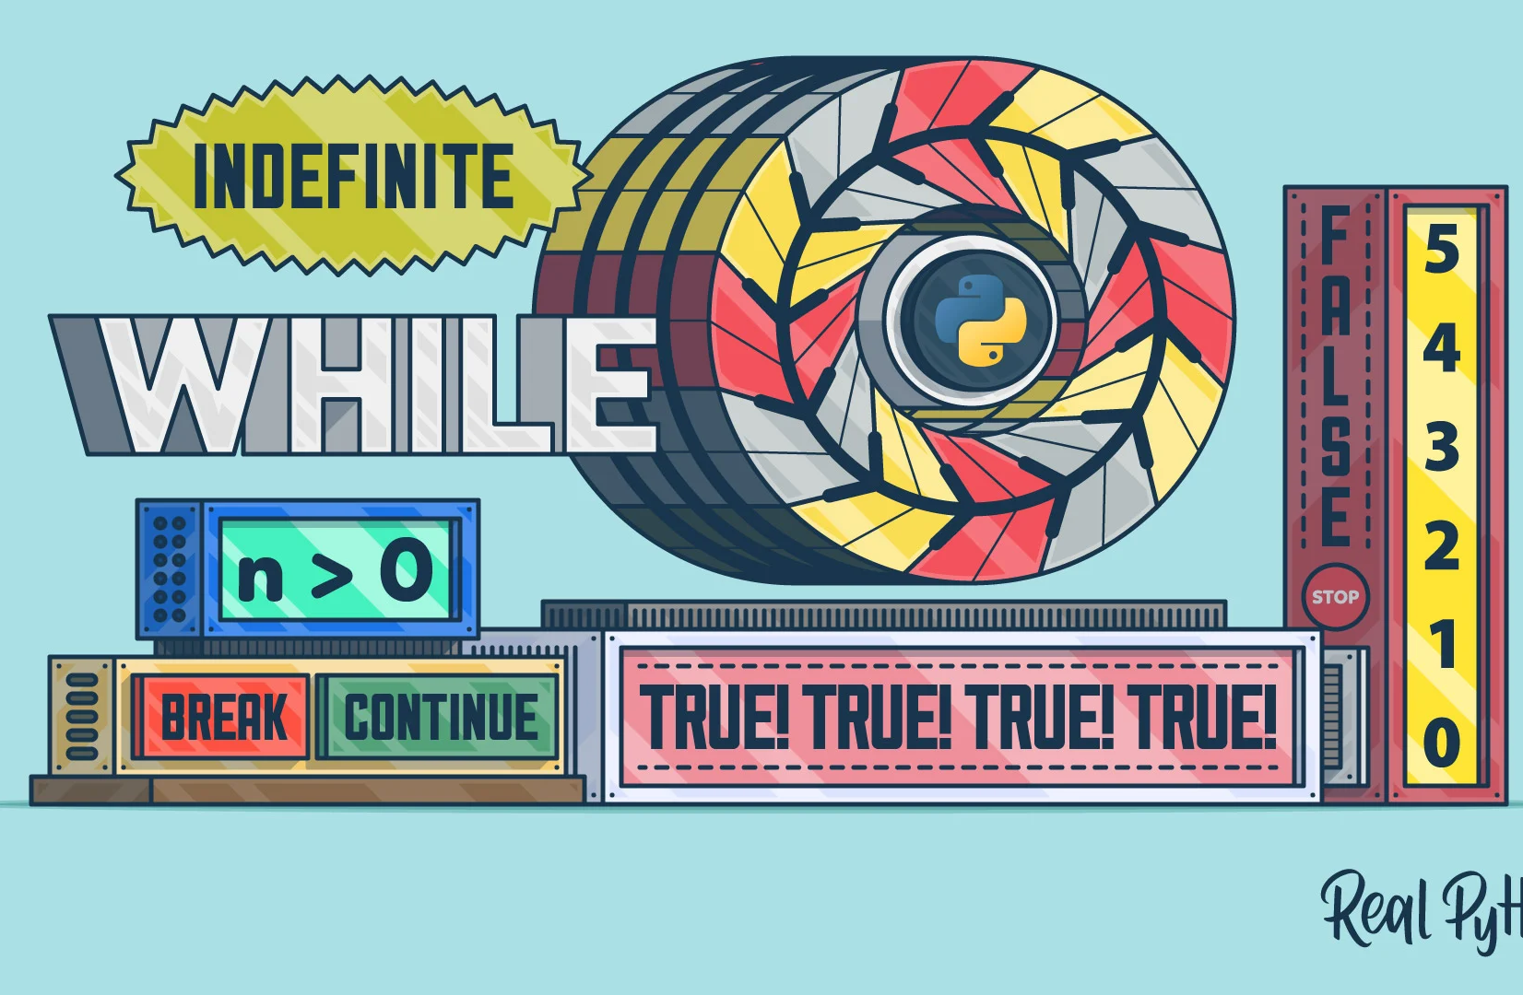
While Loop
A while loop repeatedly executes a block of code as long as a specified condition is true.
Useful when the number of iterations is not known beforehand.
Commonly used for scenarios where the loop should continue until a condition is met.
Syntax:
while condition:
# code to execute while condition is true

Slide 13
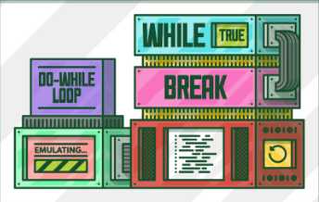
While True Loop
A while True loop creates an infinite loop that continues to execute until explicitly broken out of using a break statement.
Commonly used in applications where continuous monitoring or repeated actions are required until a stop condition is met.
Syntax:
while True:
# code to execute indefinitely
if condition:
break # exit the loop when condition is met

Slide 14
Loops with Lists
Use Loops to print each item of a list.
Syntax:
FOR LOOP
for item in list_name:
print(item) # code to execute for each item
WHILE LOOP
index = 0
while index < len(list_name):
# code to execute for each item
index += 1

Slide 15
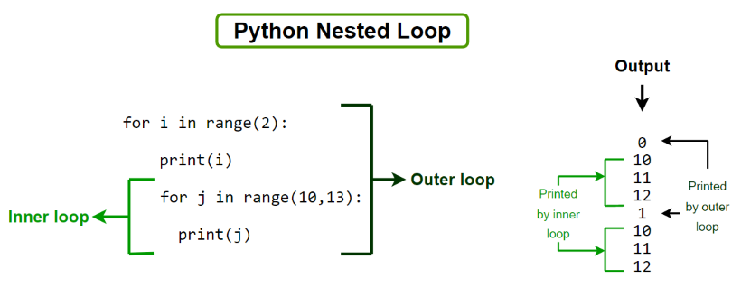
Nested Loops
Loops inside loops are called nested loops.
Useful for working with multi-dimensional data structures.
Example:
for i in range(3):
for j in range(3):
print(i, j)

Slide 16
Break and continue
Break: Exits the loop immediately.
Continue: Skips the current iteration and continues with the next one.
Example:
Break:
for i in range(5):
if i == 3:
break
print(i) # Output: 0, 1, 2
Continue:
for i in range(5):
if i == 3:
continue
print(i) # Output: 0, 1, 2, 4

Slide 17
Mini Test
Get all correct for a Prize!!
https://docs.google.com/forms/d/e/1FAIpQLScqLZBT-PQBKtu2arrOMnBTuI6PsklTyr83pd3ozOTSrlLSaQ/viewform?usp=sf_link

Slide 18
Additional Resources
Cisco Python Essentials 1 https://skillsforall.com/course/python-essentials-1?courseLang=en-US
https://realpython.com/
https://www.w3schools.com/python/python_conditions.asp
https://www.geeksforgeeks.org/python-programming-language-tutorial/

Slide 19
Preview of Next Week!!
Understand the definition and importance of functions.
Learn how to declare and call functions.
Understand the concept of parameters, return values and scope of variables.
Practice importing and using built-in modules.

Slide 20

THANK YOU FOR STICKING TILL THE END!!!
Here is Another Special Easter Egg in Python
import antigravity
Try it in your Python shell and see the result!

Slide 21
